Slide 1


Algorithms:Data Compression Tool
Notes:
1

Slide 2

Group Member
Notes:
7

Slide 3
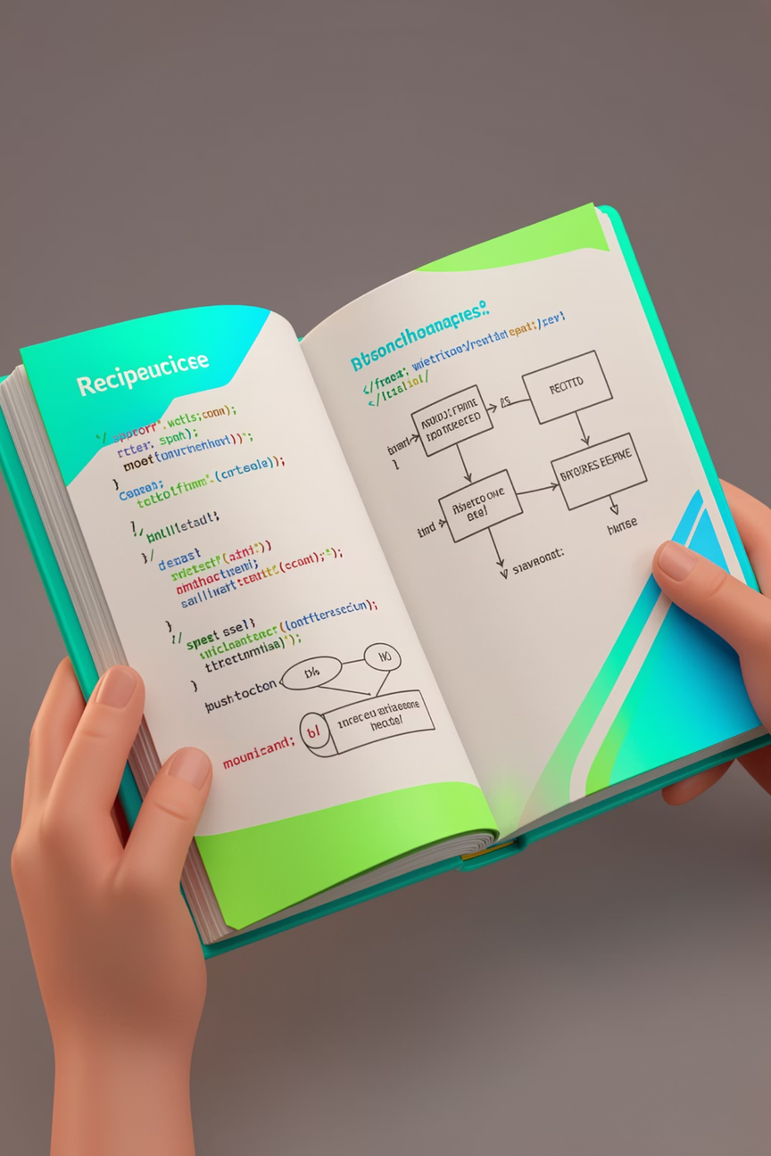
Introduction & Problem Statement
What is Huffman Coding?
It is a famous Lossless Data Compression algorithm developed by David Huffman in 1952.
It reduces file size without losing any original information.
Core Concept:
It uses Variable-Length Encoding instead of Fixed-Length Encoding.
Frequent characters are assigned shorter binary codes, while rare characters are assigned longer codes.
Notes:
2

Slide 4



Problem Statement
The Inefficiency of ASCII: Standard systems use ASCII or Unicode, where every character (like 'A' or 'Z') takes exactly 8 bits. This is a waste of memory for characters that appear very often.
Storage Constraints: As data grows globally, storing massive text files becomes expensive and difficult.
Transmission Bottlenecks: Large files take more time to upload/download and consume more network bandwidth.
The Goal: We need a way to represent the same information using the minimum number of bits possible to optimize both storage and speed.
Notes:
3

Slide 5




The Greedy Algorithm & Logic
The Greedy Strategy
Why Greedy? * Huffman Coding is a Greedy Algorithm because it makes the best local choice at each step.
It always picks the two characters with the lowest frequencies to combine first.
Goal: * To build an optimal tree where the most frequent characters are closest to the root (resulting in shorter codes).
Step-by-Step Logic
Frequency Counting: The algorithm scans the input text and counts how many times each character appears.
Min-Heap Initialization: Every unique character is placed into a Priority Queue (Min-Heap) based on its frequency.
Iterative Combination:
Extract the two nodes with the smallest frequencies.
Create a new internal node with a frequency equal to the sum of the two nodes.
Insert this new node back into the Min-Heap.
Completion: This process repeats until only one node—the Root—remains in the heap.
Notes:
4

Slide 6

Huffman Tree Construction (The Visualizer)
Building the Huffman Tree
The Blueprint: * The tree is a Binary Tree built from the bottom up.
Leaf nodes represent the actual characters.
Internal nodes represent the combined frequencies of their children.
The Path Rule:
Left branch = 0
Right branch = 1
Visualizing the Output
Structure: Our program generates a Top-Down Vertical Tree (as seen in our terminal output).
Connectors: We use sticks (|---) to show the relationship between the Parent (frequency sum) and the Child (individual character).
Tree Hierarchy: * The Root is at the very top (the total count of all characters).
The most frequent characters are higher up, requiring fewer "steps" or bits to reach
Notes:
5

Slide 7





Implementation & Coding Details
Technical Implementation
Language Used: C (Standard Library).
Core Data Structure:
struct Node: Stores character, frequency, and pointers to left/right children.
MinHeap: Used as a priority queue to always fetch the two smallest nodes.
Memory Management: Dynamic allocation using malloc to build the tree nodes.
Key Functions
buildHuffmanTree(): The heart of the program. It extracts two minimums, merges them, and re-inserts them into the heap.
storeCodes(): A recursive function that traverses the tree to generate and store binary codes for each character.
printTreeVisual(): Our custom visualizer that uses recursion and spacing to print the tree vertically.
Data Handling
Frequency Map: An array of size 256 to count character occurrences.
Bitstream Generation: A loop that replaces every original character with its newly generated Huffman code to form the compressed string.
Notes:
6

Slide 8

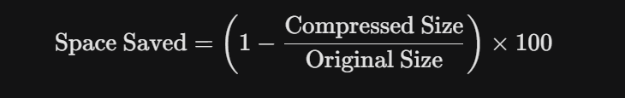
Results, Statistics & Conclusion
Analyzing the Results
Step-by-Step Output: Our program displays the frequency table, the visual tree, and the generated binary codes.
The Encoded Bitstream: We show the original text converted into a dense string of 0s and 1s.
Efficiency: You can clearly see that characters like 'e' or 'space' might only take 2 or 3 bits, whereas rare characters take more.
Final Statistics
Original Size: Calculated as (Number of characters × 8 bits).
Compressed Size: The total number of bits in the Huffman encoded stream.
Space Saved Percentage: Calculated using the formula:
Notes:
7

Slide 9
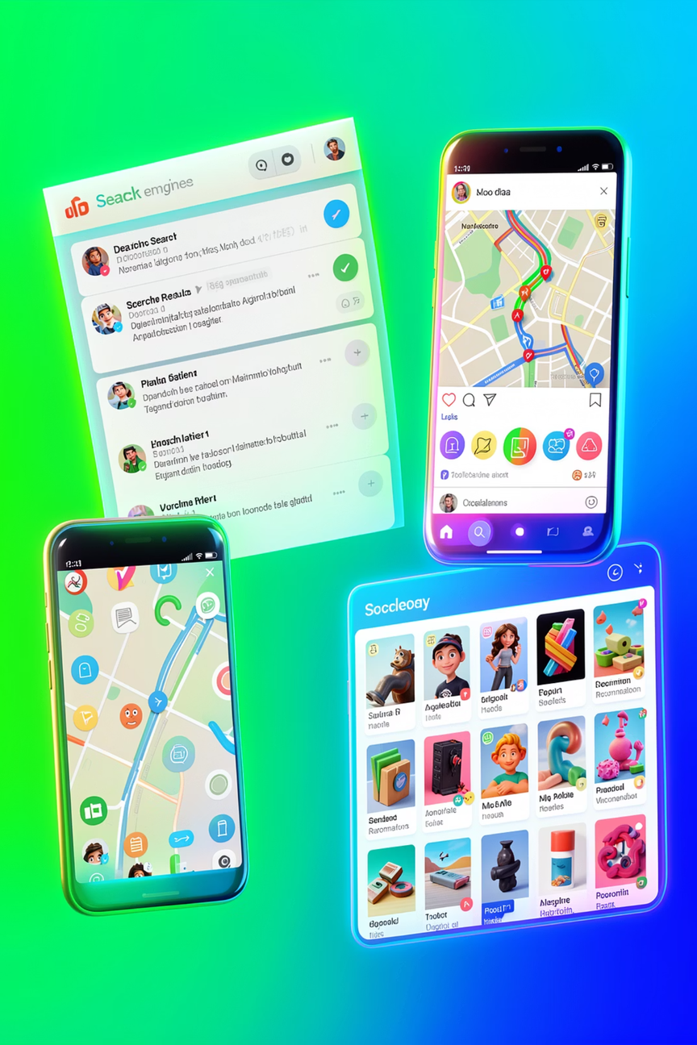
Conclusion & Future Scope
Conclusion: We successfully implemented a Lossless Data Compression tool using a Greedy approach and Binary Trees.
Future Scope: * Implementing file I/O to read and write actual .txt and .zip files.
Adding a Decompression (unzipping) feature to reconstruct the original text.
Extending the tool to handle images or audio files using bit-level manipulation.
Notes:
8

Slide 10
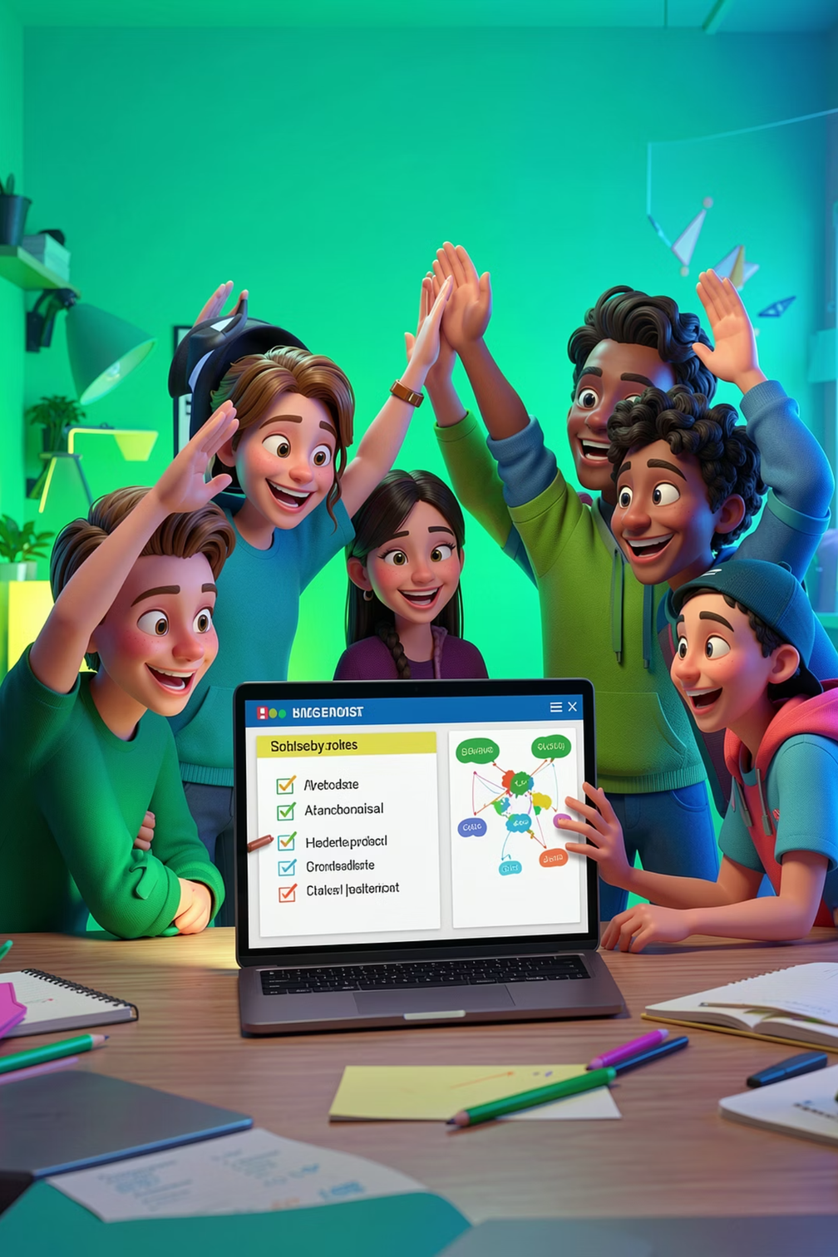
Thank You
Notes:
1

